Slide 1

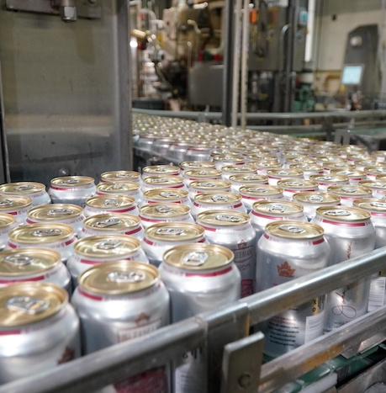
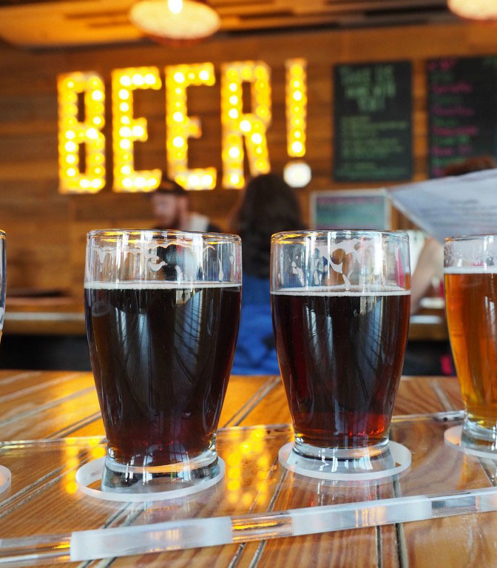

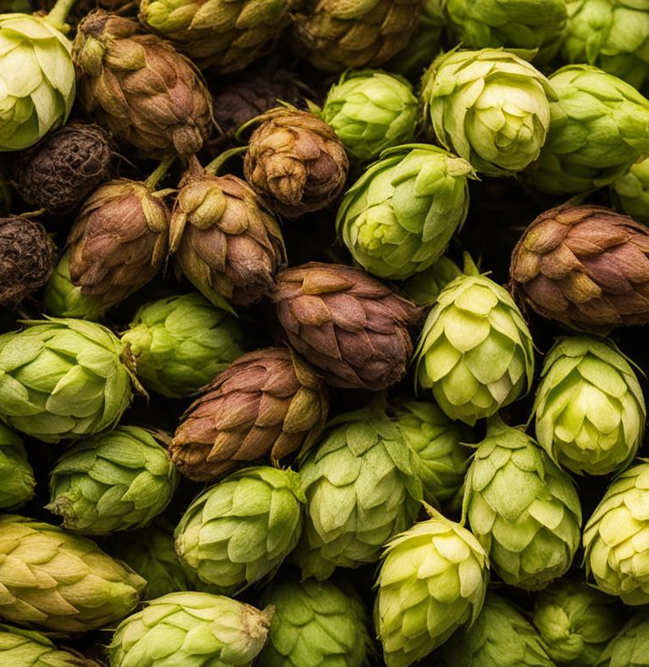
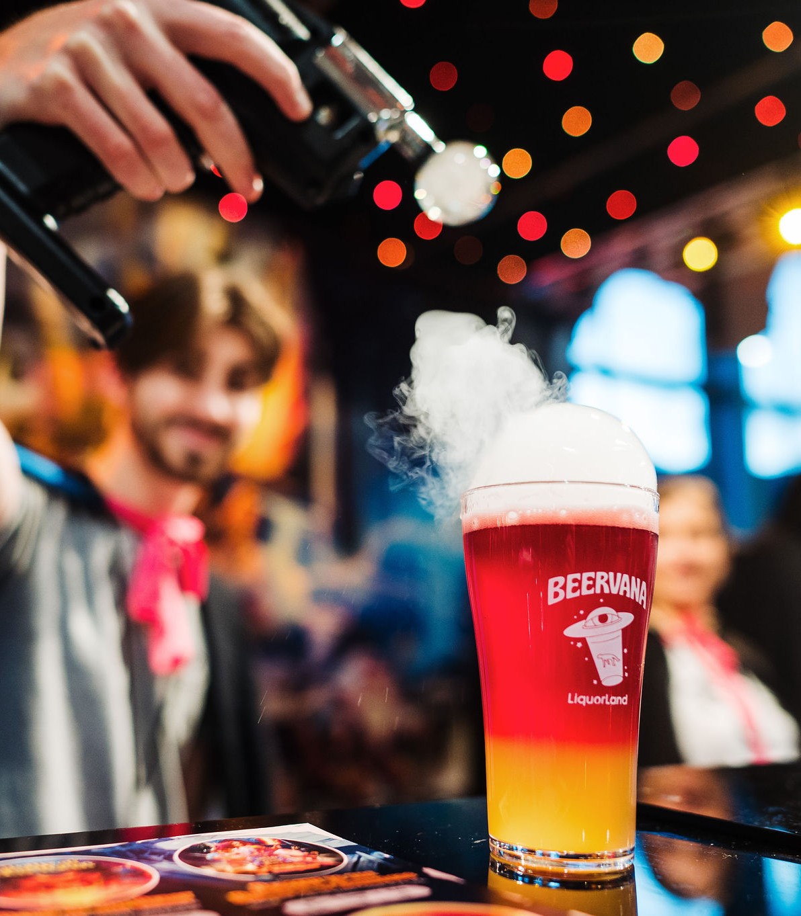
Economic Contribution of the Brewing Industry in New Zealand
REPORT
Version 3.0 (share)

Slide 2

SECTION 1
ECONOMIC ANALYSIS

Slide 3
Economic Analysis
Objectives
To leverage the Oxford Economics and national data sources to model the economic impact of the beer industry in New Zealand.
To estimate the direct and indirect economic contribution and include estimates for employment, revenue, taxes and investments.
Additionally, to then use national data sources and the Brewers Guild industry survey to model the regional economic impact of the beer industry in New Zealand.
Methodology
Oxford Economics published Beer’s Global Economic Footprint in January 2022 and a subsequent draft case study on Beer’s economic footprint in New Zealand for 2023.
Following discussions with the authors, Maven has leveraged this case study to determine the 2023 economic impact of the beer industry in New Zealand. Where we have been able to improve the estimates, via alternate industry data sources, we have done so.
Oxford Economics has split the production cycle into two components - ‘Brewers’ and ‘Downstream value chain’. The ‘Brewers’ component incorporates the production at the brewery and includes all the organisations that provide inputs to the brewers. The ‘Downstream value chain’ component incorporates all the organisations that contribute to the beer industry beyond the gate of the brewer (e.g. transportation, retail, hospitality etc.). Additionally, the model provides estimates for the direct production; the supply chain; a wage-induced effect (i.e. employees spending wages generate further economic activity) and supply chain investments (economic impact of capital investments).
Page 4 sets out the model visually and the table at the top of page 5 provides the definitions of the components.
Our model estimates the impact on GDP and employment across all the sub-components.

Slide 4
Economic Analysis – Model Definitions for GDP
Beer production cycle
Model terminology
BREWERS
DOWNSTREAM VALUE CHAIN
GDP impact of…
Direct
Production at breweries and those in the breweries downstream value chain
Distribution
Retail
Hospitality
Raw inputs
Breweries
Supply chain
Those industries supplying into the brewing industry, across the production cycle
Employees
(who spend their wages in the economy and induce more economic activity)
Employees
(wage induction)
Employees across the production cycle who induce further economic activity through spending their wages
Wage induced
Spending on capital
(Economic impact of the industry - who supply brewers, and the breweries - spending on plant and machinery)
Spending on capital
(Post Breweries)
Supply chain investments
Capital spending across the production cycle, which generates economic activity
Total GDP impact

Slide 5
Economic Analysis results – Total GDP impacts
Key messages
Total GDP impact of the brewery industry in 2023 is estimated at NZD$3.58 billion. This equates to 0.9% of total GDP (Source: Infometrics – annual GDP to March 2023)
The $3.58 billion is made up of $1.47 billion impact generated by the brewers, and industry that sit in their supply chain, and $2.12 billion generated through the breweries downstream value chain.
Almost $2 billion of the total impact is through the production of beer – be it the industry supplying inputs, the breweries themselves, and all the industry associated with the post-production distribution, retail and hospitality.
Almost $1 billion of the total impact is the result of employers across the full production cycle spending wages and inducing further economic activity.
$650 million of the $3.58 billion is the result of all industries in the production cycle investing in capital.

Slide 6
Economic Analysis – Model Definitions for Employment
Beer production cycle
Model terminology
BREWERS
DOWNSTREAM VALUE CHAIN
Employment effect of…
Direct
Production at breweries and those in the Breweries downstream value chain
Raw inputs
(total employees)
Breweries
(total employees)
Distribution
Retail
Hospitality (total employees)
Supply chain
Those industries supplying into the brewing industry, across the production cycle
Employees
(who spend their wages in the economy and induce more employment)
Employees
(employment induction)
Employees across the production cycle who induce further employment activity through spending
Wage induced
Spending on capital
(Employment impact of the industry - who supply brewers, and the breweries - spending on plant and machinery)
Spending on capital
(Post Breweries)
Supply chain investments
Capital spending across the production cycle
Total Employment impact

Slide 7
Economic Analysis results – Total employment impacts
Key messages
Total employment impact of the brewery industry in 2023 is estimated to support 35,200 jobs. This equates to 1.3% of total employment in New Zealand (Source: Infometrics – total employment 2023).
We estimate that breweries in New Zealand employ a little over 2,000 staff and a further 11,500 New Zealanders are employed beyond the brewery – be it providing transportation, warehousing, retailing, or hospitality.
The beer industry is reliant on, and supports, a large supply chain. We estimate 4,600 New Zealanders are employed to provide inputs to the 2,400 New Zealanders who produce beer.
Of the total number of jobs directly associated with the brewing industry (35,200), approximately one third of the jobs are created to the point where beer is ready to leave the brewer, and two-third are created in the downstream value chain.

Slide 8
Economic Analysis results – Total tax impacts
In addition to the GDP and employment effects, the Oxford Economics methodology has been used to estimate the tax impacts of the beer industry for 2023. Using a similar methodology, we are able to estimate the income and business tax paid across the beer production cycle. The ‘Brewers’ sector in the table below incorporates the tax paid by the brewers and the organisations providing inputs prior to production. The ‘Downstream value chain’ estimates the tax paid by all organisations beyond the brewery, post beer production.
For the ‘Beer sales (excise and GST)’ estimate, NZ Customs data has been used to calculate the excise on New Zealand produced beer and the import duties on imported beer. The GST estimate is based on an estimate of total beer sales in New Zealand in 2022, sourced from the NZIER “Brewing in New Zealand” report for the Brewers Association of New Zealand.
This shows that almost $1.7bn of taxes (income, business, GST, excises) are collected by the government each year, based on the GDP impact the beer brewing industry creates in New Zealand. 19% percent ($326 million) is paid by the breweries and all organisations contributing their inputs; a further 29% ($488 million) is paid by the organisations downstream from the breweries. The remaining 52% ($881 million) of revenue is collected through GST and excise duties. This is made up of $430 million in GST; $385 million of excise on New Zealand produced beer and $66 million of excise imposed on imported beer.

Slide 9

SECTION 2
REGIONAL ANALYSIS

Slide 10
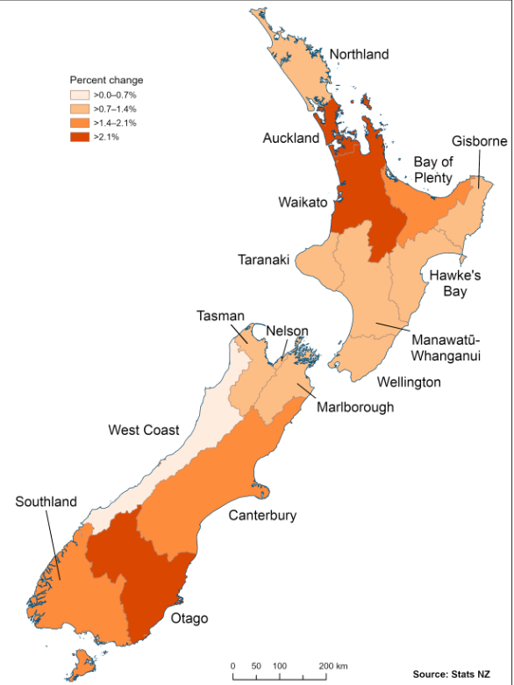
Regional Analysis
Objectives
To take the national GDP and Employment estimates and attribute these to New Zealand regions. For the purpose of this work we have used the Statistics New Zealand definitions of regional boundaries (per the diagram on the right)
To provide regional estimates as a bridge to the regional analysis determined from the Brewers Guild industry survey analysis.
Methodology
Our approach has been to apportion the national estimates across regions via a proxy measure, except where we can utilise
industry-sourced data to more accurately refine the estimate.
The proxy chosen is the Statistics New Zealand Gross Domestic Product by industry, by region, for the year ended March 2022. Within this series we use the Food and Beverage Services industry type, by region.
There are three instances where we attempted to use (2 were successful, the third is on hold until we can get more data in 2025) industry-sourced data to refine the regional estimates. These instances are:
For the regional analysis of GDP:
To refine the direct GDP impact for the breweries we used actual production levels, by region for Lion, DB and Asahi and modelled production levels by region for the Brewers Guild industry survey respondents from their recent industry survey.
To refine the supply chain GDP impact we sought data on the value of hops, malt and yeast, by region from the major industry suppliers. We were able to get a ‘near-complete’ view of the value of hops by region, but were unable to get complete information on malt and yeast. This component may be integrated in early 2025 when the industry is able to supply the data. In the meantime, the proxy described above is used.
For the regional analysis of employment:
To refine the employment data in breweries we used actual employment data, by region for Lion, DB and Asahi and modelled the employment levels by region for those breweries who responded to the Brewers Guild industry survey.

Slide 11
Economic Analysis results – Regional GDP impacts
Key messages
Auckland dominates the regional story with 42% of the total GDP estimate attributable to this region. This compares to Statistics New Zealand estimating that Auckland accounts for 38% of total national GDP. Differences in regional GDP are shown in the second chart.
The difference in the GDP beer percentage for Auckland compared to the national GDP percentage is driven by the proportionally higher beer production level in this region. In 2023, industry data showed that 88% of beer was produced in Auckland. This percentage changes markedly between the Brewers Association members (93% produced in Auckland) and Brewers Guild members (24% produced in Auckland).

Slide 12
Economic Analysis results – Regional employment impacts
Key messages
As per the GDP regional estimates, the Auckland region dominates with 40% of the employment effect attributed to this region.
Wellington and Canterbury, both at 12%, make up the next 24% of beer related employment across New Zealand.

Slide 13
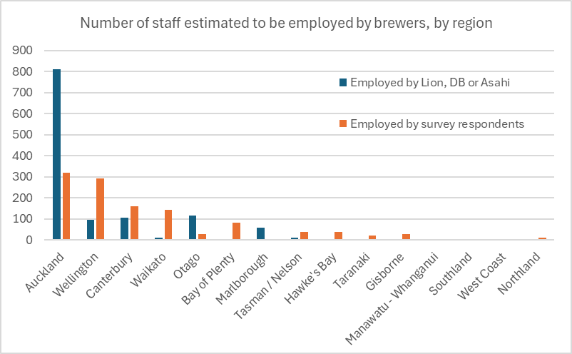
Economic Analysis results – Regional employment impacts
Estimated staff employed in Breweries
 | Brewers Association | Brewers Guild | Total
Auckland | 812 | 320 | 1132
Wellington | 95 | 292 | 387
Canterbury | 108 | 160 | 268
Waikato | 10 | 142 | 152
Otago | 118 | 29 | 147
Bay of Plenty | 0 | 82 | 82
Marlborough | 58 | 6 | 64
Tasman / Nelson | 10 | 38 | 48
Hawke's Bay | 3 | 39 | 42
Taranaki | 4 | 23 | 27
Gisborne | 0 | 28 | 28
Manawatu - Whanganui | 0 | 6 | 6
Southland | 3 | 0 | 3
West Coast | 2 | 1 | 3
Northland | 0 | 11 | 11
Total | 1223 | 1177 | 2400
Methodology
Lion, DB and Asahi were able to provide their current (2024) number of employees, by region. These three organisations account for 51% of the total staff employed by breweries.
To estimate the number of staff employed by members of the Brewers Guild, we have modelled this off the 2024 Industry Survey responses.

Slide 14
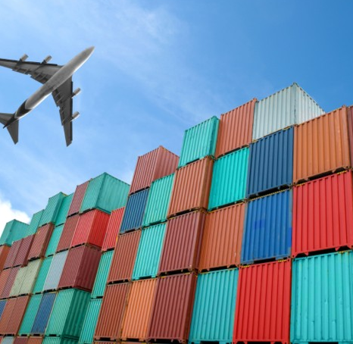
SECTION 1
EXPORTS

Slide 15
Exporting versus size (production)
Key Messages
Our whole industry contributes to New Zealand’s
export success.
A higher proportion of our bigger producers export
their product, but even our smaller brewers have
found opportunities offshore.
Irrespective of size, the industry are seeking opportunities to build their businesses offshore.

Slide 16
Exporting versus size (revenue)
Key Messages
The smallest breweries who took part in the survey - those with annual revenue less than $125,000 - focus solely on the domestic market.
We’re an industry that chases export earnings quickly in the business growth cycle. Of those survey respondents who have annual revenues of a modest $125,000 - $250,000, almost 40% of them are exporting.

Slide 17
Exporting – from which regions?
Key Messages
Auckland is our biggest beer exporting region. Over 60% of survey respondents based in Auckland are exporting. A total of 10 businesses.
Our beer exports come from half of New Zealand regions, with Auckland and Wellington being the most popular regions.
Thirty percent of Brewers Guild industry survey respondents are exporting beer.

Slide 18
Exporting – desired growth
Key Messages
Within two years, almost half of our the industry survey respondents are intending to export their product.
The biggest percentage growth, by region, is Taranaki with all brewers in that region intending to export within two years.
Currently we have eight (of fifteen) New Zealand regions that don’t export beer. Within two years this is intended to reduce to five.

Slide 19
Exporting growth by size
Key Messages
Exporting aspirations of survey respondents are high. Their view is that you don’t need to be large to grow offshore. Even our smallest brewers intend to start exporting within the next two years.
A third of our mid-sized brewers (600,000 to 2,000,000 litres) are intending to start exporting in the next two years.

Slide 20
Beer – terms of trade
Messages
A COVID export dip, consistent with a number of industries, but this is turning.
With 16% of our brewers intending to start exporting in the next two years, this trend is expected to climb.

Slide 21
Who do we trade beer with?
Key Messages
Australians drink 70% of our beer exports.
Close location matters (beer doesn’t travel well) so our top ten exports are all in the APEC region.
We found no distinguishable demographics between those that export to Australia vs those that export to any other country.

Slide 22
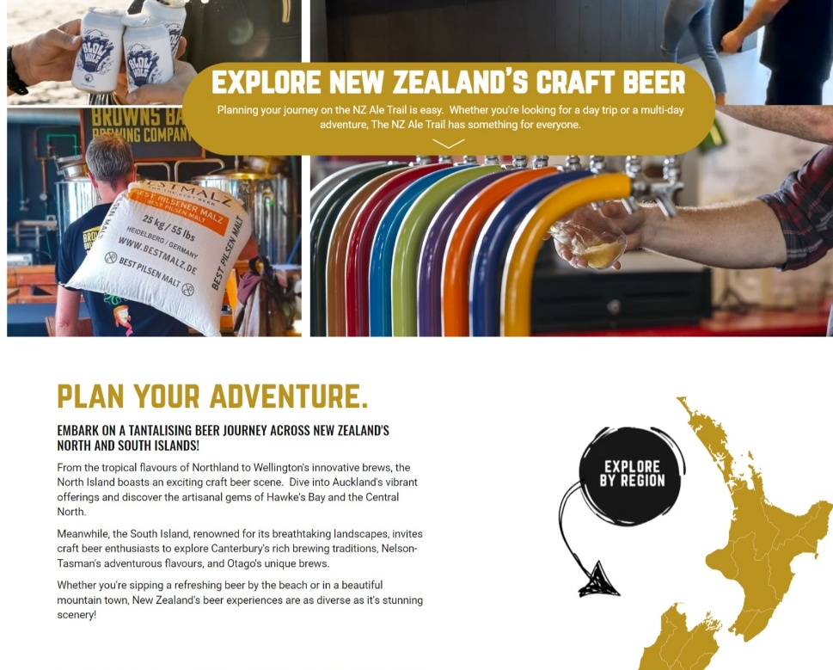
SECTION 2
TOURISM

Slide 23
Breweries engaging in tourism opportunities
Key Messages
Over 60% of our breweries are engaging in tourism opportunities in their local area.
Our very small brewers (less than 50,000 litres) have the smallest proportion who engage in tourism. But, impressively, despite their size, about 50% of them still engage in tourism opportunities.

Slide 24
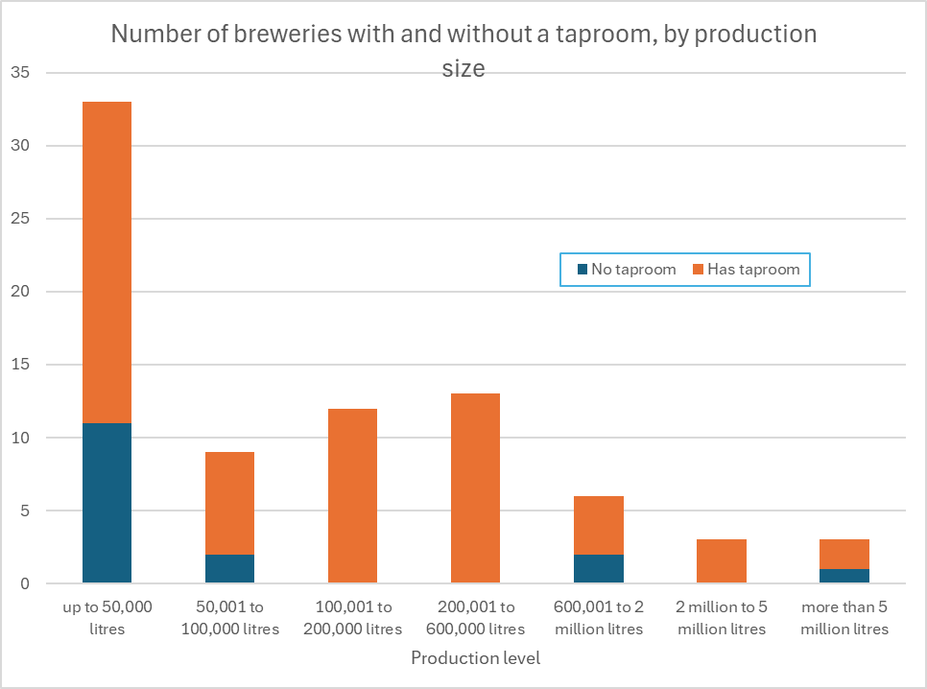
Breweries offering taprooms
Key Messages
Brewery taprooms provide a point of interest for tourists to visit as they move throughout our regions. As well as providing a useful point-of-sale for the brewer, they provide tourists a unique experience.
Almost 80% of Brewers Guild industry survey recipients offer taprooms.
Not unexpectedly, the production level with the smallest proportion of taprooms are our smallest breweries (less than 50,000 litres). That said, two-thirds of these breweries are still offering a taproom.

Slide 25
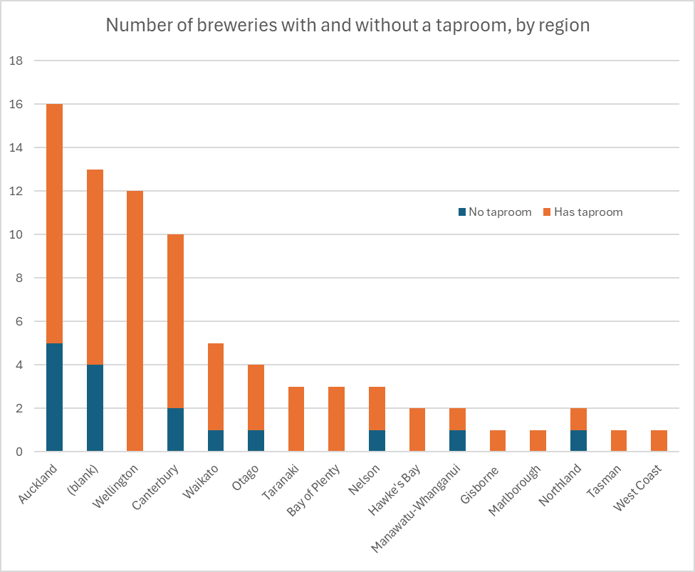
Brewery taproom locations
Key Messages
Good distribution of taprooms across New Zealand.
Every region in New Zealand has taproom representation.

Slide 26
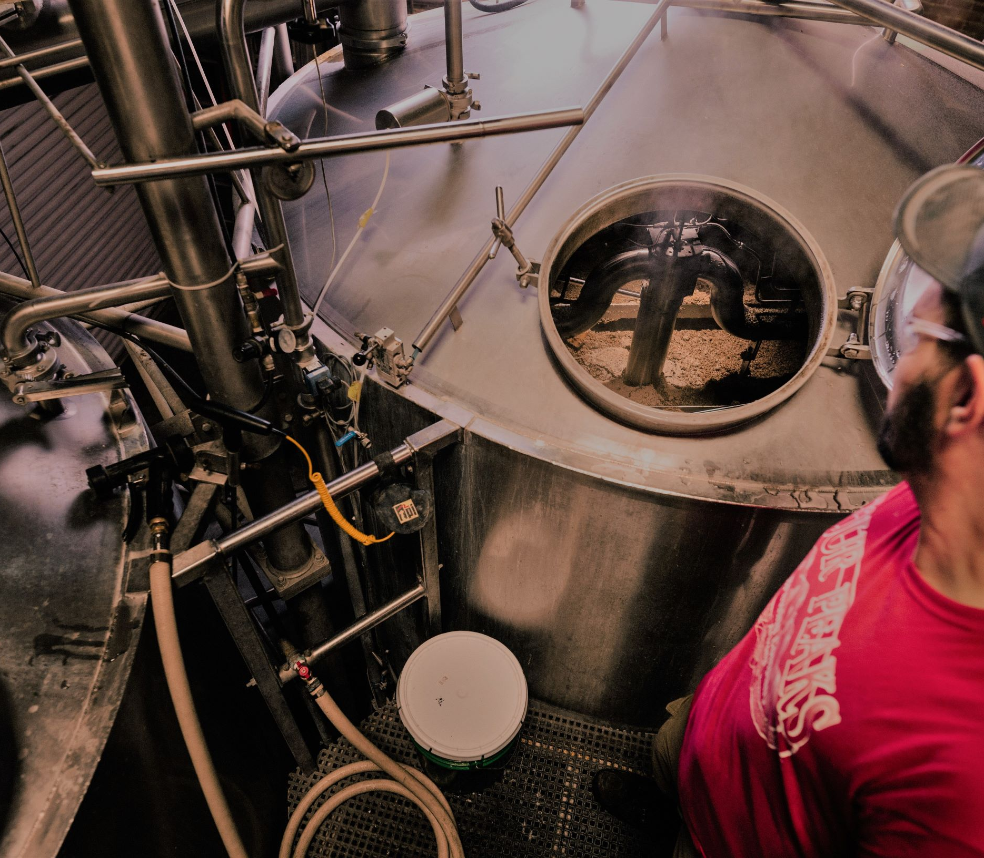
SECTION 3
EMPLOYMENT

Slide 27
Employment in breweries
Key Messages
Almost 2,000 fulltime employees in the Brewers Guild industry survey respondents. Note that this is higher than the 1,177 quoted on page 13 as this number includes brewers who are members of both the Brewers Association and the Brewers Guild.
Almost 65% of total employment is in the two largest survey respondents.

Slide 28
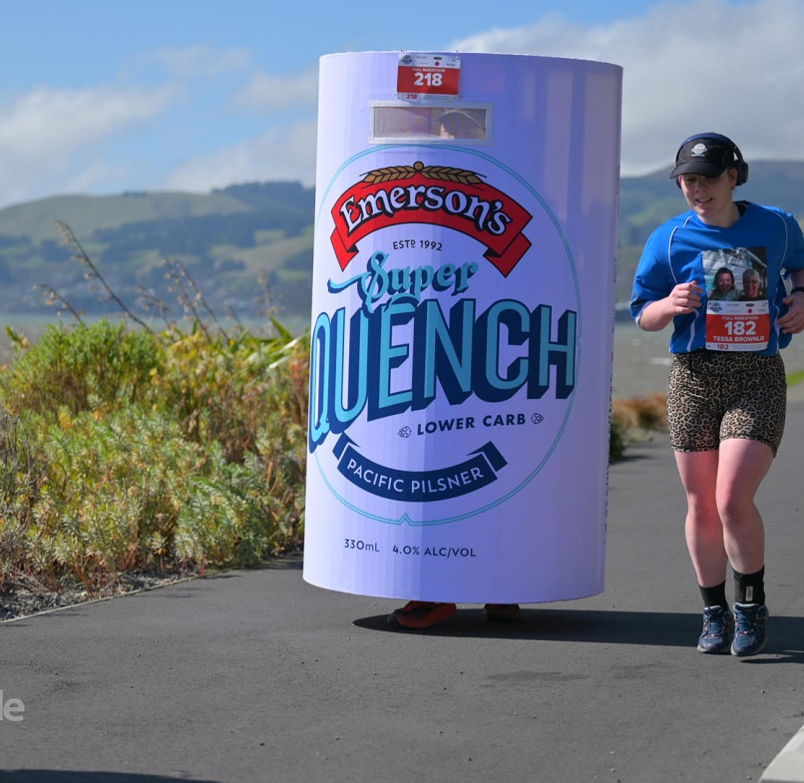
SECTION 5
COMMUNITY CONTRIBUTION

Slide 29
Engaging in local communities
Key Messages
85% of all brewers can identify a community contribution they are making.
Breweries across New Zealand can identify positive contributions to their local communities.

Slide 30
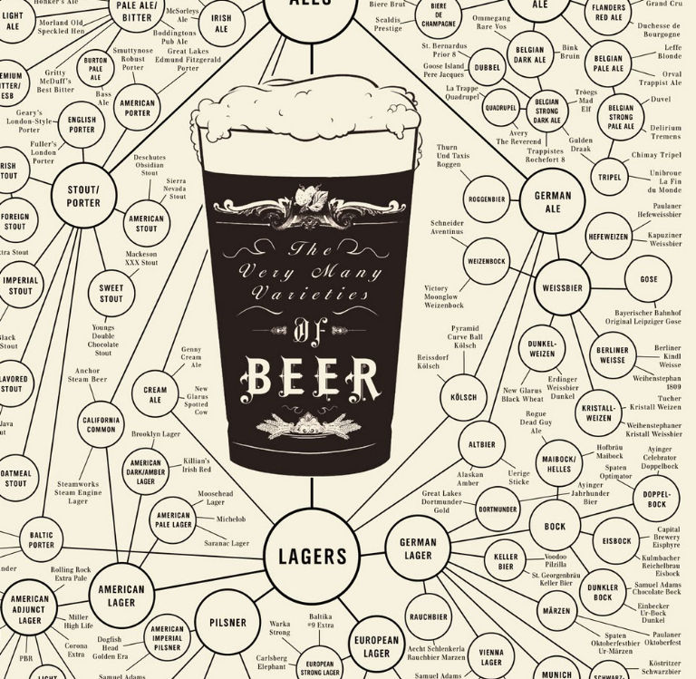
SECTION 6
BEER STYLES

Slide 31
Beer sub-segments
Source: Neilsen NZ

Slide 32
Beer styles
Source: Neilsen NZ

Slide 33
Craft beer styles
Source: Neilsen NZ

